Slide 1

Weather Station
Tracy MacAulay-Higgan
05004513
Embedded Systems Project 2

Slide 2
About my project
I wanted to make a weather station to track the changes in weather conditions. I have been interested in making one of these for a while and it was both fun and frustrating creating this.

Slide 3
Issues faced
During the making of this project I did face a few issues which I had to research to fix.
Firstly the LCD screen was temperamental and even when the wires hadn’t been touched it didn’t always work. This I found meant I usually had to rewire it from the start each time when I moved the setup.
Secondly the first sensor – temperature and humidity, this is meant to read out to the LCD screen but on the odd occasion this did not work. Turns out this also worked better when rewired.
Each time things failed I went back to square one and started testing the LCD screen when that was working I added the next sensor and tested it and so on until everything was added and working.

Slide 4
Research
For the different sensors I looked for libraries to use I did manage to find some for all of them.
They came in handy.
Add links to code used

Slide 5
Collecting data
Instead of just using the Serial Monitor in the Arduino IDE I decided to research how to put the data into Excel and log it before turning it into a graph.
This required turning on datastreamer and setting it up on here.
It also meant I had to amend the code in the Sketch to allow to print in CSV. This took some working out to get it right but I was good when it finally started outputting data correctly.

Slide 6
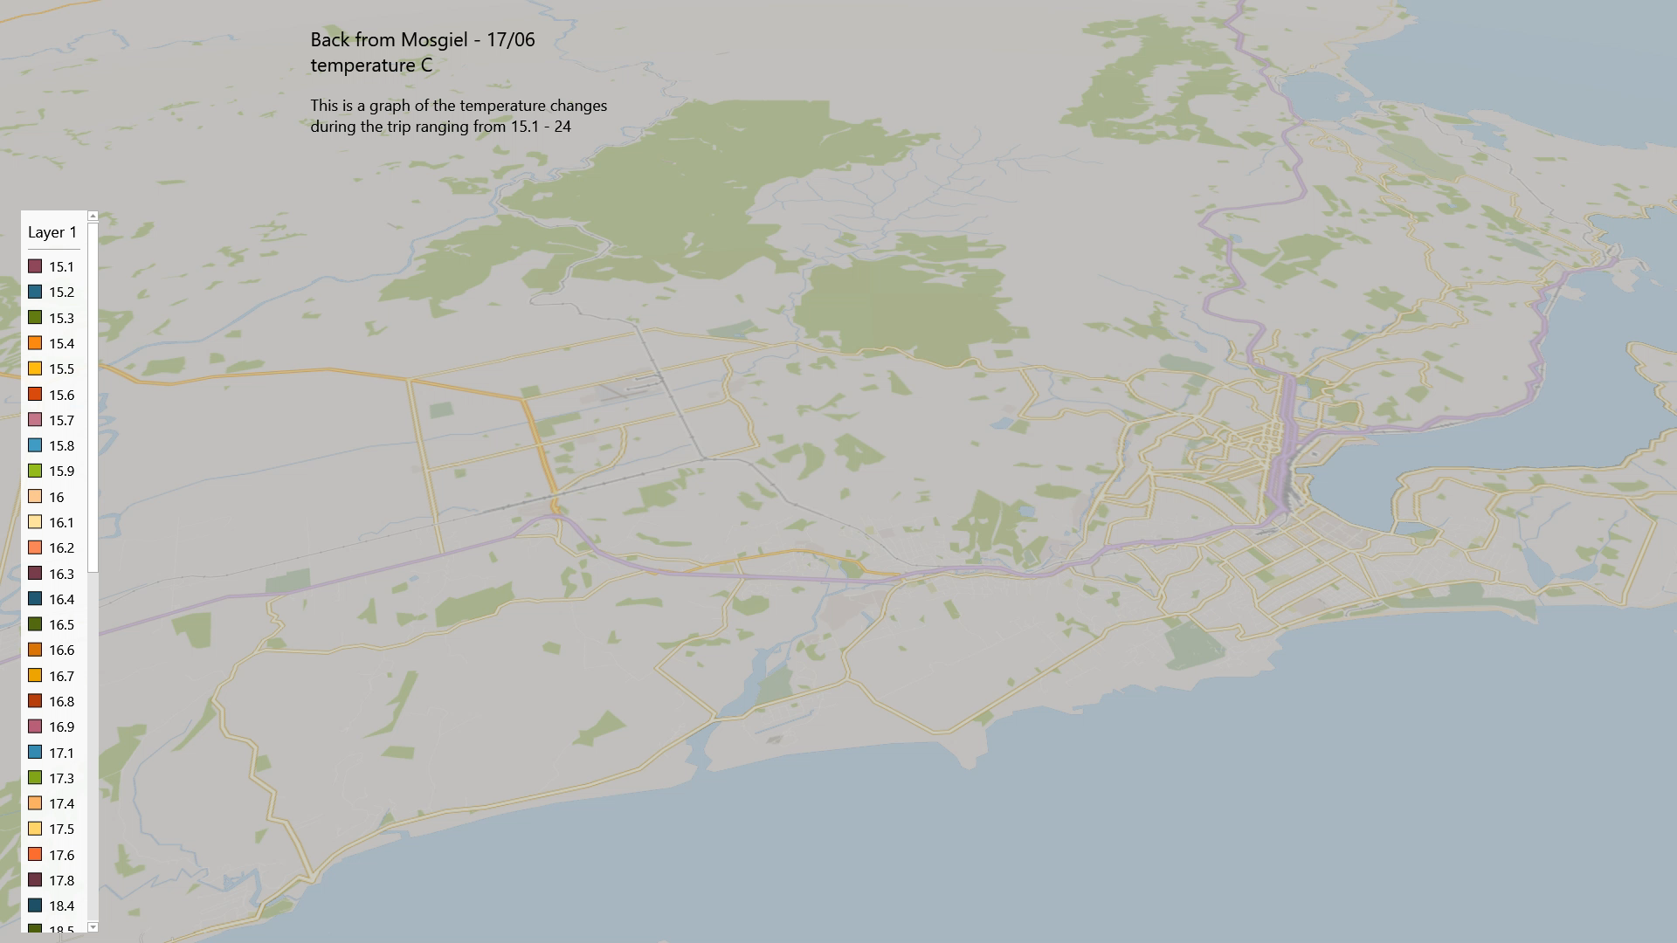
Graph of data collected on a trip to Mosgiel

Slide 7
Graph of data collected for a time at home

Slide 8
Learnings
The SPL06 sensor seemed to pick up some unusual readings for the altitude this could be fixed with some further research. The readings for South Dunedin were quite a way below sea level and even at Saint Clair beach it was below sea level.

